Slide 1


DHS Data Management and Analysis of Gender Inequality in Reproductive Women across LMICs
Presentation
Ijeoma Nwachukwu
3rd Sept, 2025

Slide 2
Project Background
Project Objectives
DHS Program suspension: Data request/registration on pause
Create global repository and analyse Gender Inequality Variables
Key aspects:
Intimate Partner Violence (IPV)
Female Genital Mutilation (FGM)
Healthcare Decision-Making autonomy
Data source: IPUMS-DHS harmonised datasets for cross-country comparability
Develop reproducible workflows for DHS data management and analysis
Analyse gender inequality patterns across multiple countries
Create interactive visualisations of key gender indicators

Slide 3
Methodology
Analysis Approach
Tools: R Markdown, SPSS for cross-tabulations and visualisations
Descriptive, unweighted analysis across countries (1986-2021)
Interactive visual plots created from SPSS output tables
Limitations:
Not population-weighted - frequencies not adjusted by country size
Sampling variations may influence cross-country comparisons
Not all countries have data for all years and variables
Interpretation based on descriptive patterns, not causal claims
Phase 1: Auto-download of DHS Datasets
R Markdown workflow for secure data access
Automated downloads and systematic file organisation
Phase 2: DHS IR File Merge (Pilot Merge)
Merged Individual Recode datasets for Kenya and Tanzania 2022
Created cross-country unique identifier (UCASEID)
Phase 3: Exploratory Data Analysis using IPUMS-DHS
Harmonised datasets for cross-country analysis

Slide 4
Key Outcomes
Analysis Results
Intimate Partner Violence (IPV):
Visible cross-country variation in slapping incidents
Afghanistan, Liberia, DRC show highest rates (>20%) Outputs
Female Genital Mutilation (FGM):
Extremely high rates in Guinea, Sierra Leone, Mali (>80%)
Healthcare Decision-Making:
Most women don't decide alone on their healthcare
Often husband/partner makes or influences decisions
Outputs Delivered:
DHS Downloads with Structured file organisation.
Reproducible DHS data pilot merge using SPSS (Kenya-Tanzania 2022, DHS 8)
Reproducible Cross-country workflows for exploratory data analysis using SPSS and R

Slide 5
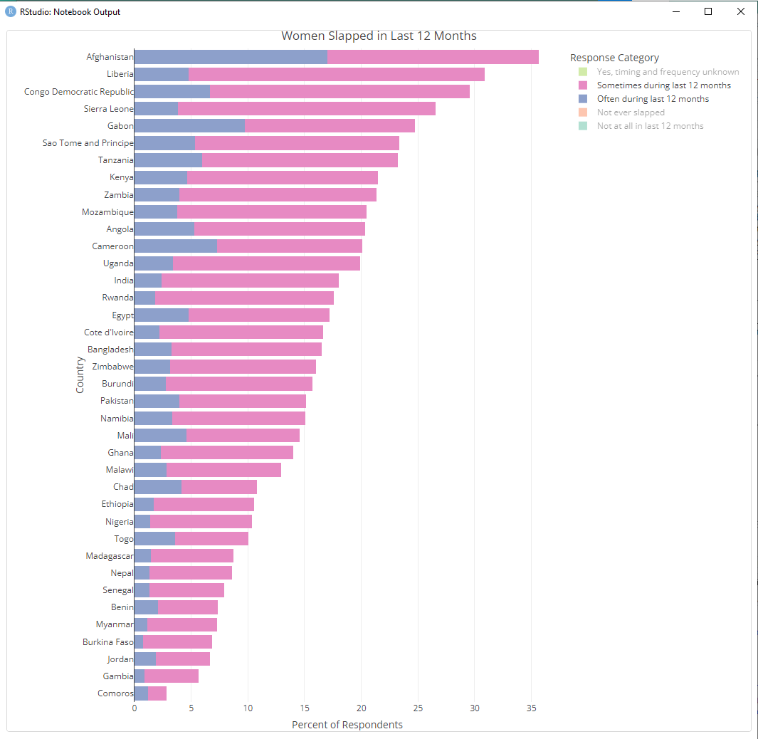
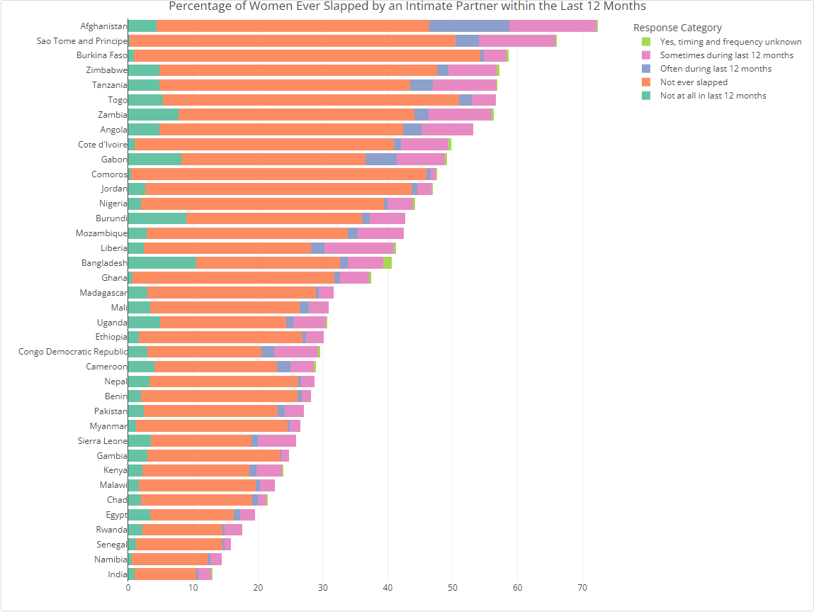
IPV: Visible cross-country variation in slapping incidents Afghanistan, Liberia, DRC show highest rates (>20%)

Slide 6
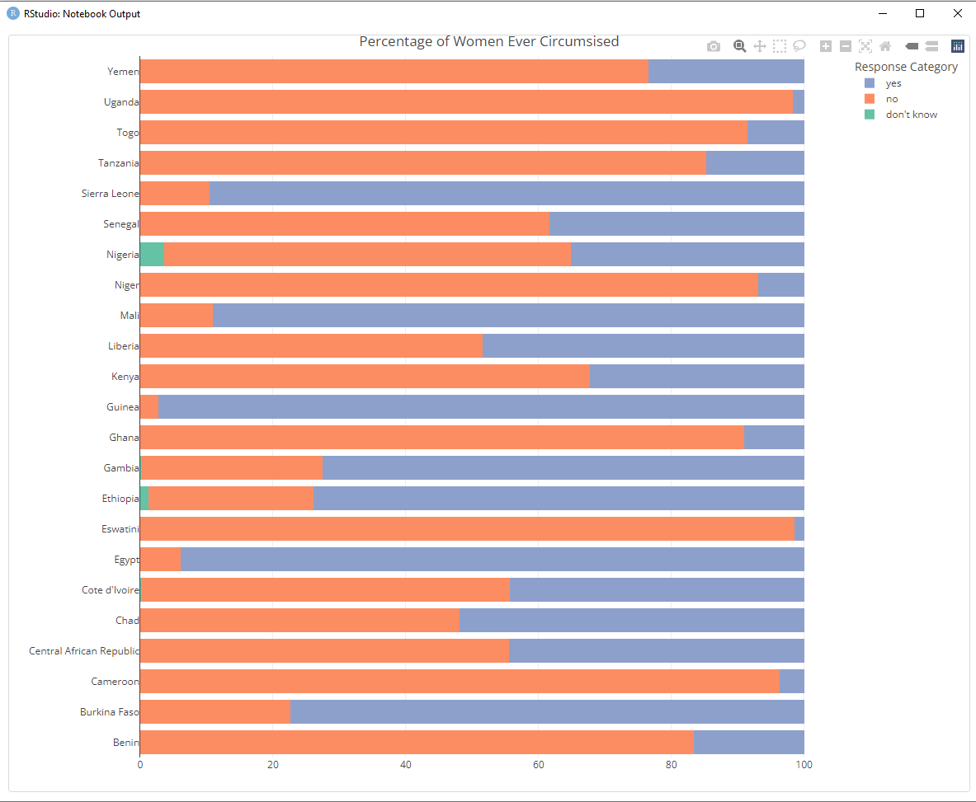
Female Genital Mutilation (FGM):
Extremely high rates in Guinea, Sierra Leone, Mali (>80%)

Slide 7
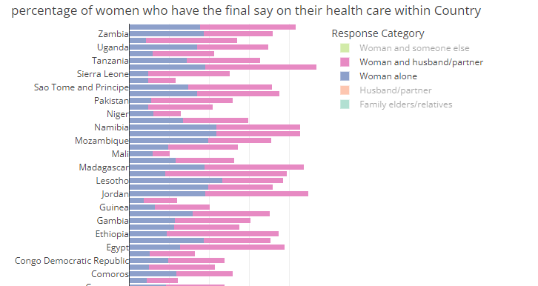
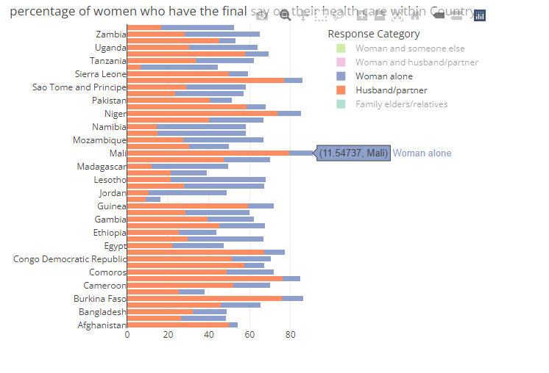
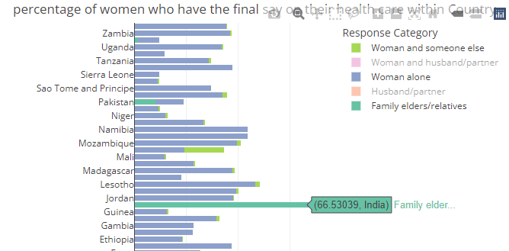
Healthcare Decision-Making:
Most women don't decide alone on their healthcare
Often husband/partner makes or influences decisions

Slide 8
What Next?
Build my portfolio
FGM Project volunteer
Register with DHS Program: Decide on project that interest me (suggestions?)

Slide 9
Thank YOU!

